Slide 1
Pulse PT
Rafael Montes
Parth Desai
Sam Bohr
Andrew Alhaj
Daniel Christenson
Julian Ajja

Slide 2
Risks and Challenges
Research for Documentation
Tedious CSS
Implementation of Redux
Retrieving Refresh Token
Error Testing
Rafael
Sam
Andrew
Daniel
Julian

Slide 3
Sprint 7 & 8 Work
Some wireframes for the mobile application was created early on in the sprint
Final documentation worked on
Sequence Diagram for the most part done, need to update some elements of it based on the group’s feedback.

Slide 4
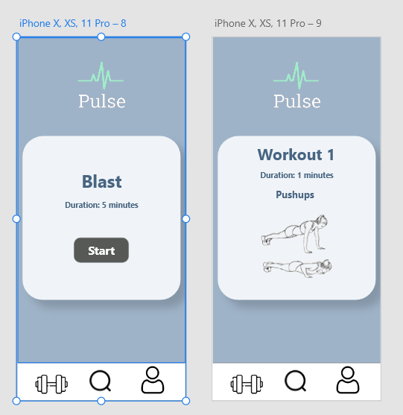
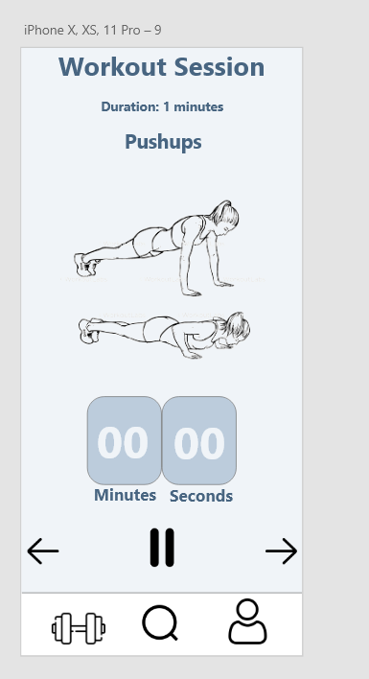

Slide 5
Styling Updates
As a trainer, I would like better look and feel such that pages are easier to use and navigate.
Utilizing HTML components to edit page layout
Improvements to aesthetics using CSS

Slide 6
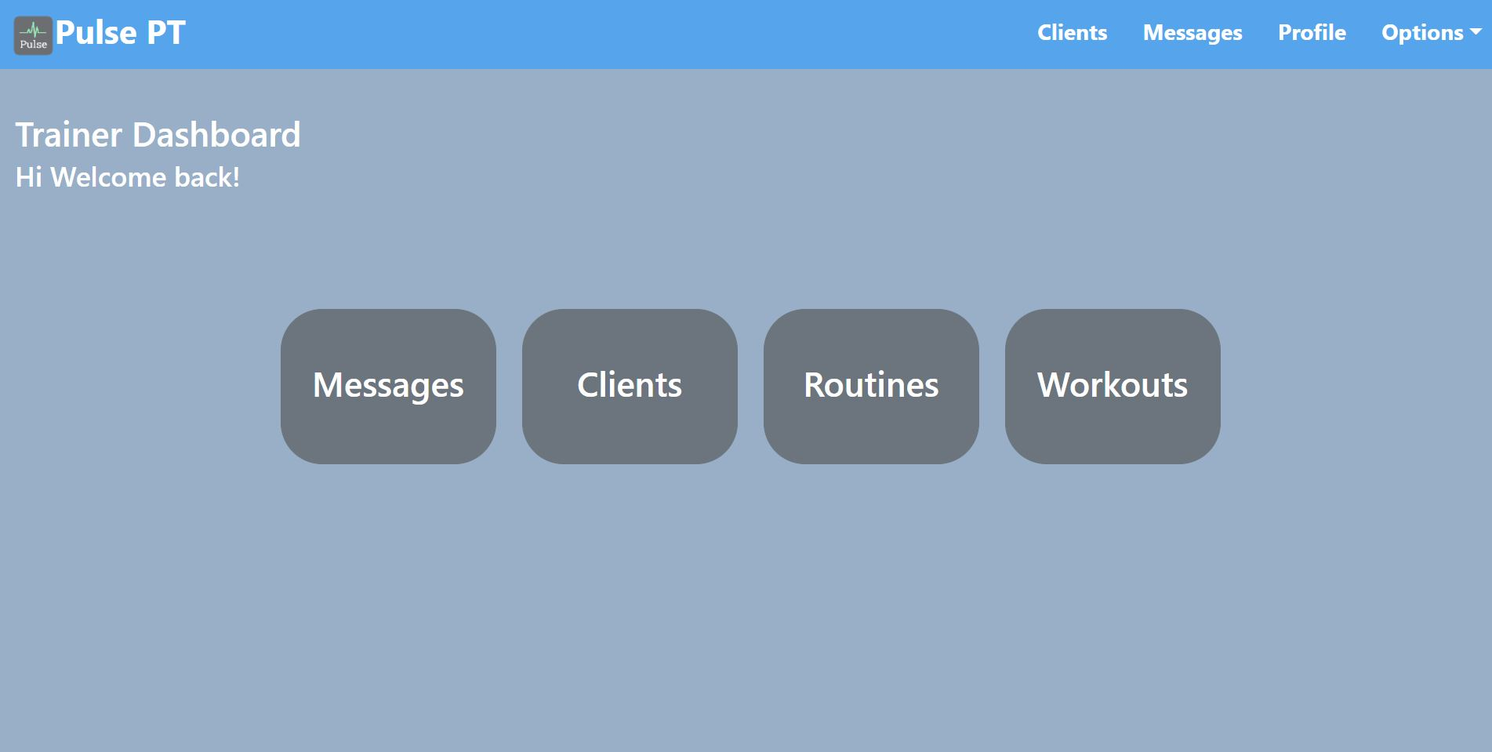
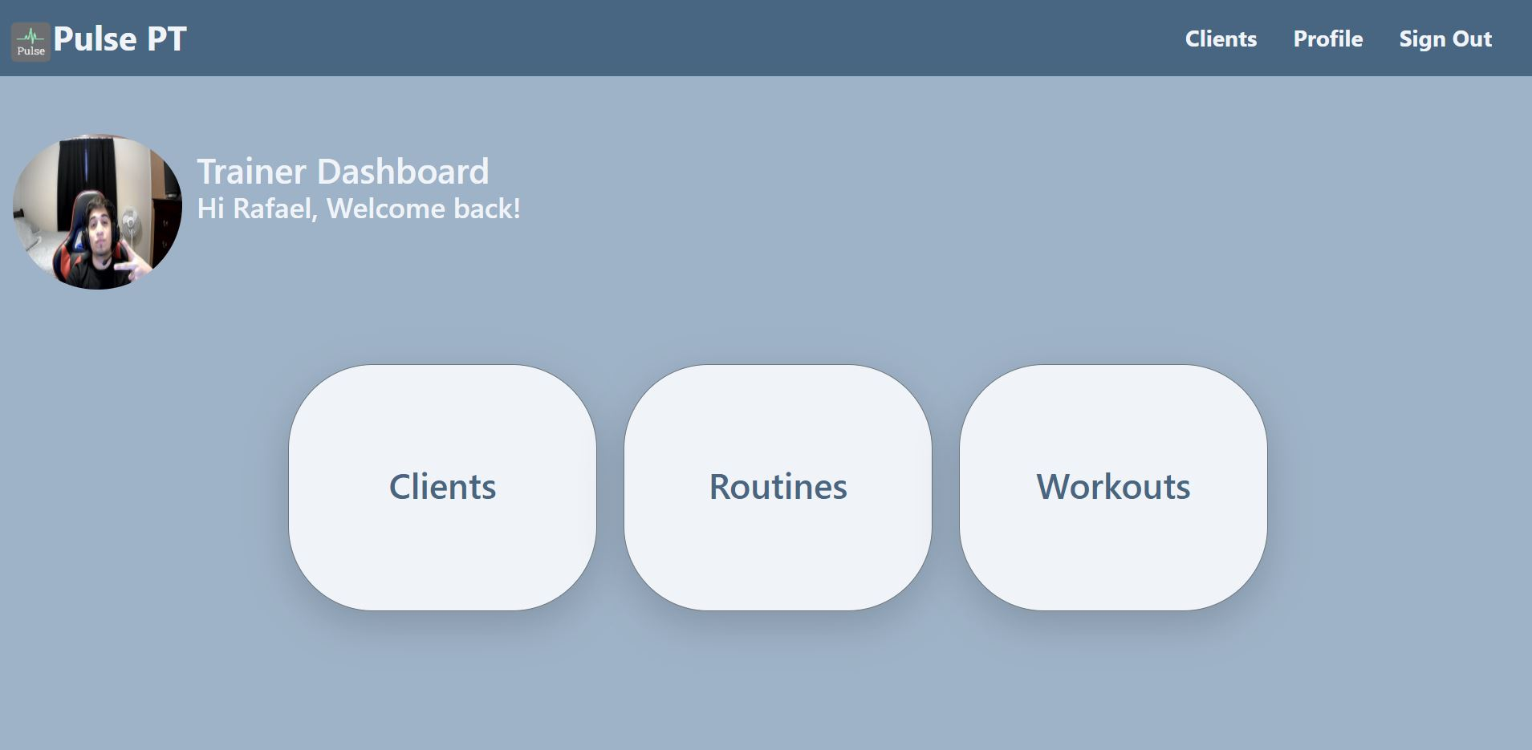

Slide 7
Workout Updates
As a trainer, I would like the list of workouts to have images displayed for easier navigation.
Converted the workout table to a list of cards with reactstrap, allowing images to be shown on each workout card.
As a trainer, I would like to be able to add GIFs to my workouts. This will give clients a better demonstration on how to execute the routine.
Research for gif implementation
Created new field to add gif and displayed it in the workout module.

Slide 8
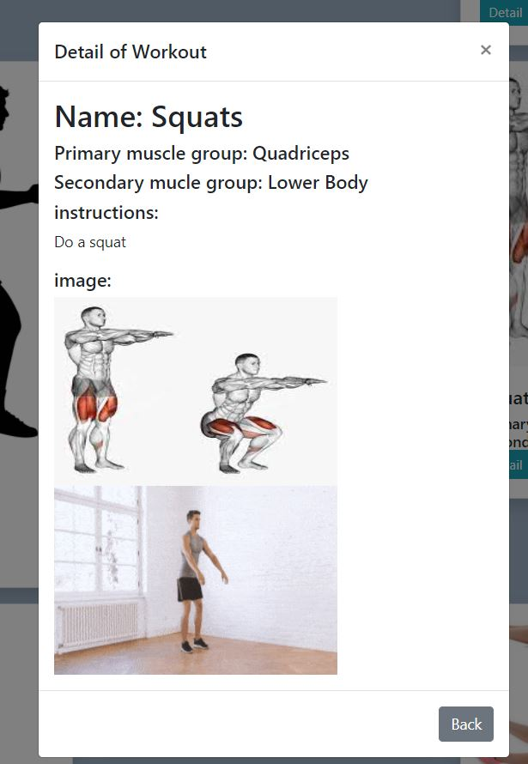
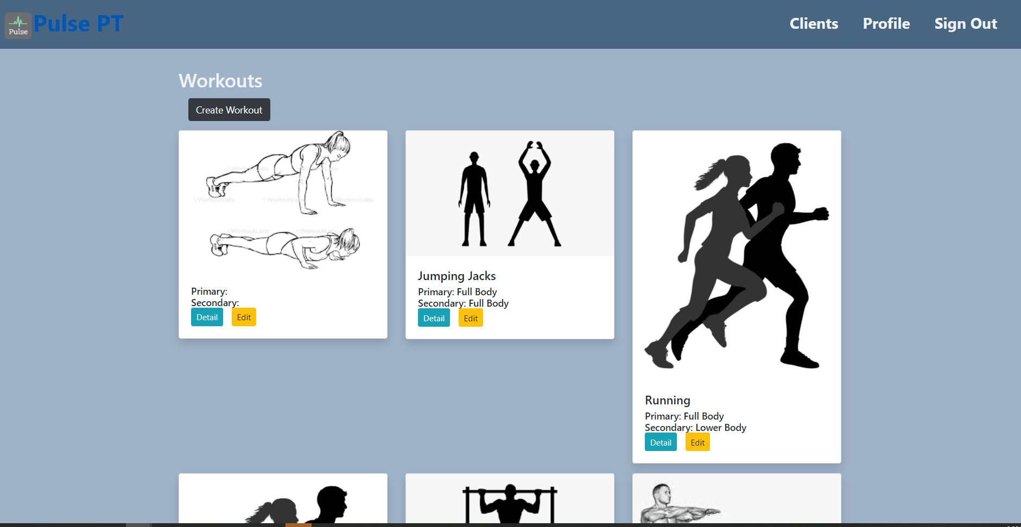
Workout Updates

Slide 9
Mobile Profile Workoutlist
As a subscriber, I would like to search for a list of available workouts and routines.

Slide 10
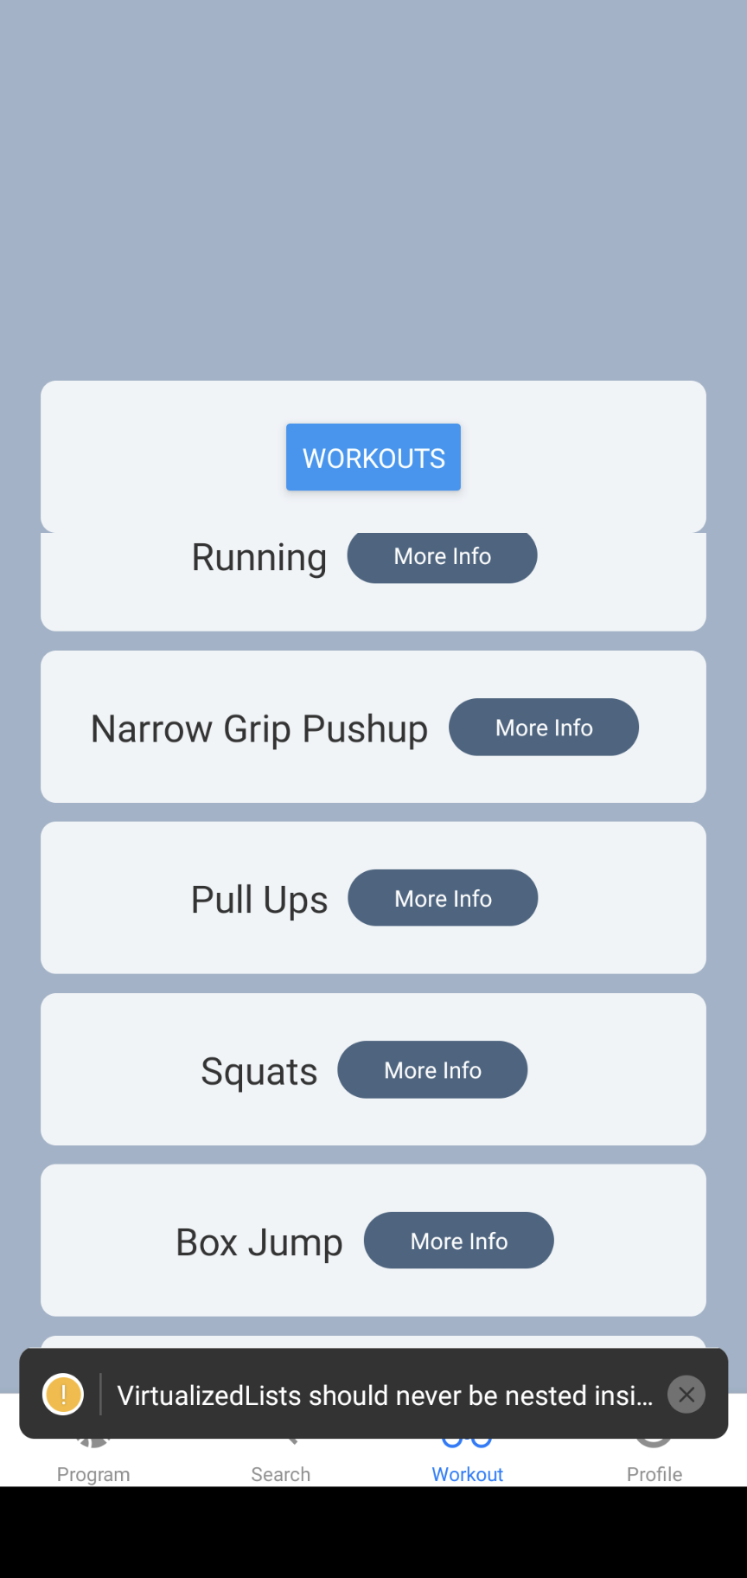
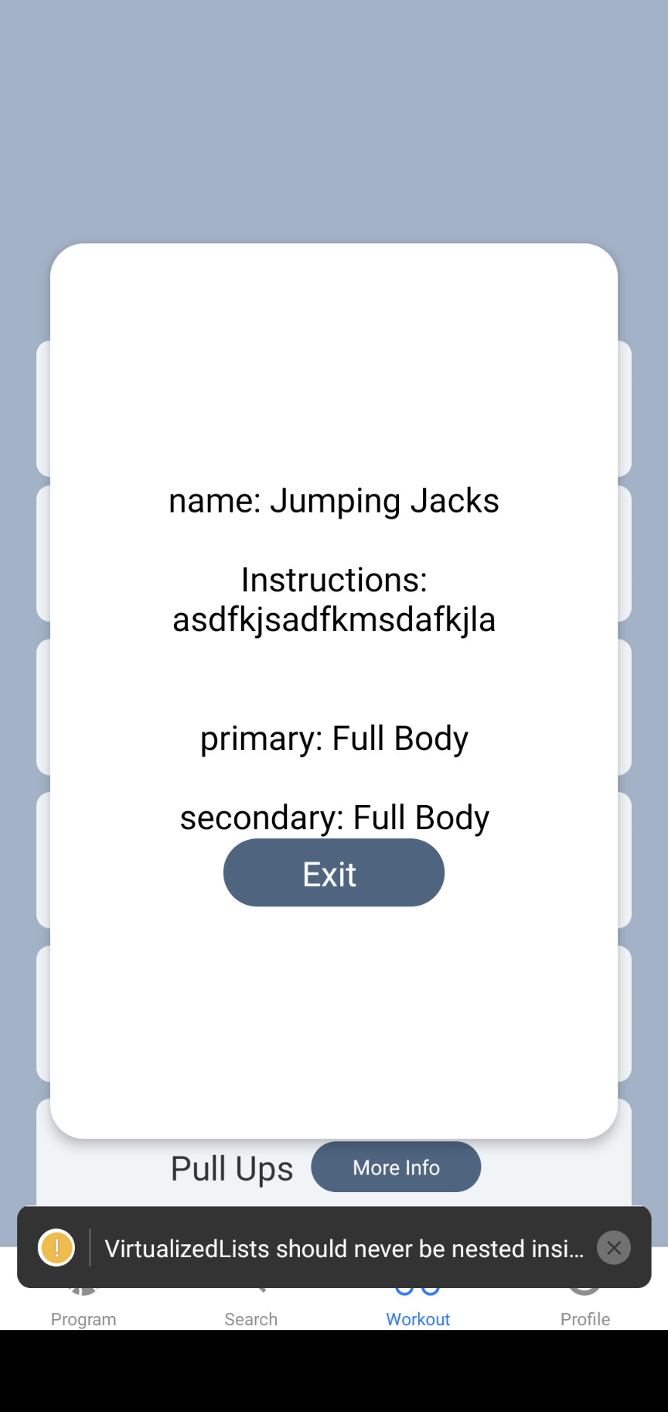
Mobile Profile Workout list

Slide 11
User Stories for next Sprint
Documentation, CSS

Slide 12
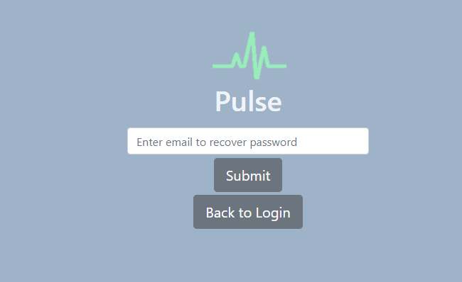

Forgot Password
User Story: As a trainer, I would like to be able to recover my password if I forget it.
Research
Create new Route
Implement using Firebase
Test

Slide 13

Profile Update
User Story: As a trainer, I would like a profile page that is pleasing to look at
Research
A lot of tedious CSS

Slide 14
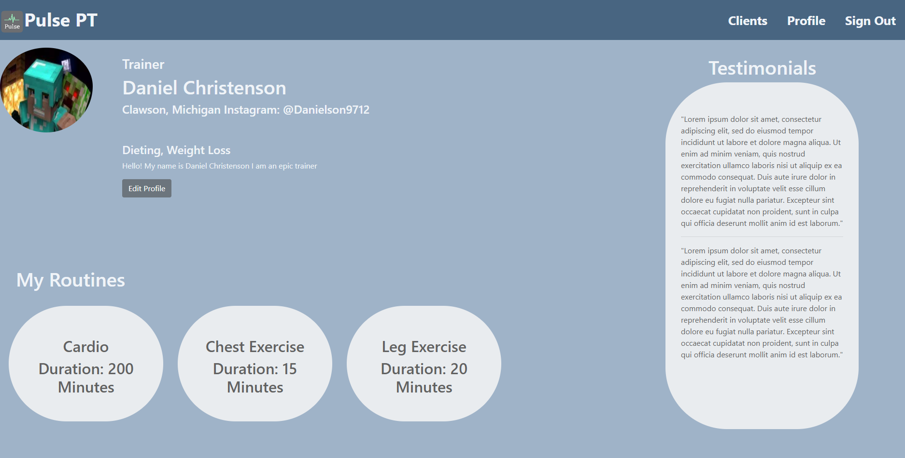
Profile Page

Slide 15
Next Objectives
Continue to clean up CSS
Help out with documentation

Slide 16
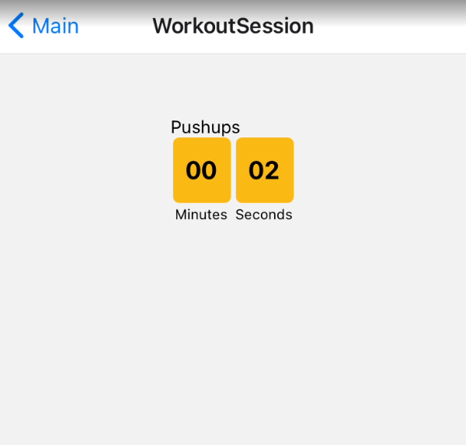
Workout Session Page
User Story:
As a user, I would like to begin doing my assigned routines.
As a user, I would like a timer indicating the remaining time of a workout
User selects the routine that he or she would like to do.
Able to traverse through a routine.
Timer reflects the current workout.

Slide 17
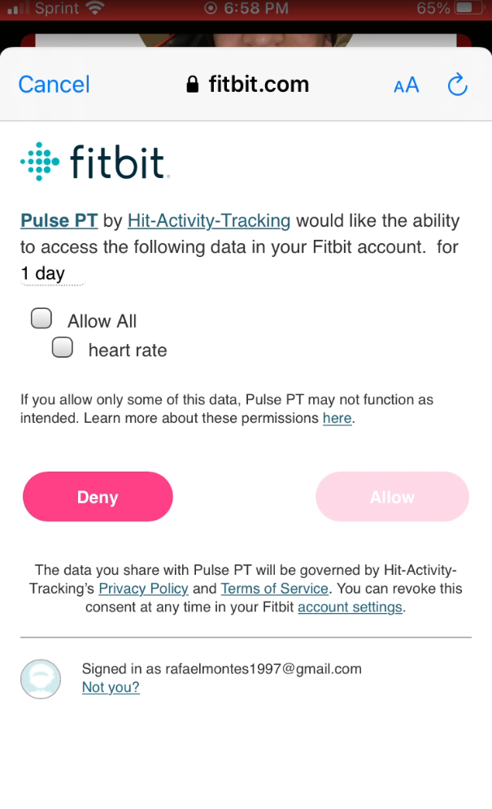
Fitbit Connection
User Story: As a subscriber, I would like to authorize the app to retrieve my heart rate data.
As a subscriber I would like my heart rate to be recorded during a session
Able to ask user for permission to track their heart rate
Able to record heart rate during workout session

Slide 18
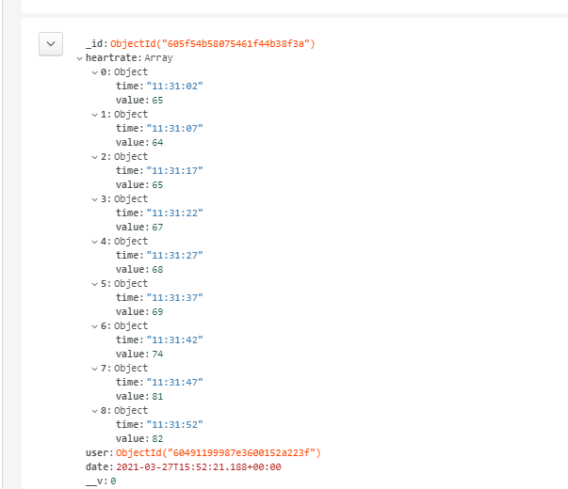
Heart rate data

Slide 19
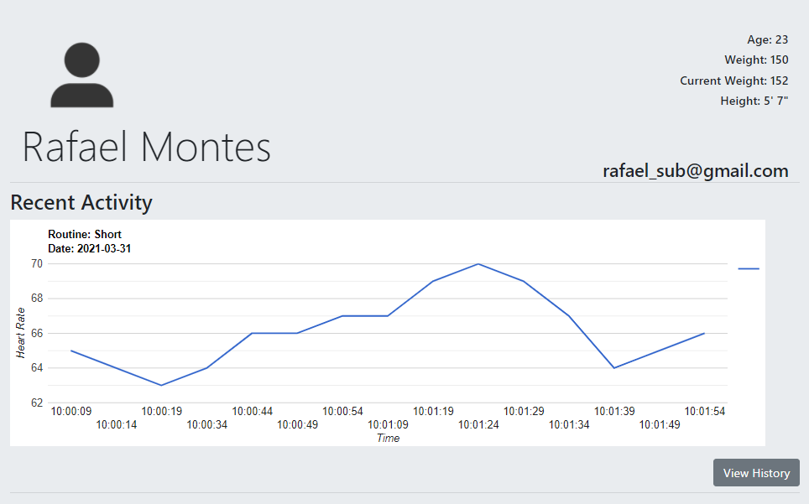
Heart Rate Graph
User Story: As a trainer, I would like a graph that displays my clients workout data
Able to display heart rate data
Google charts
Created a View history page which shows previous workout data

Slide 20
Next Objectives
Work on deliverables
Testing

Slide 21
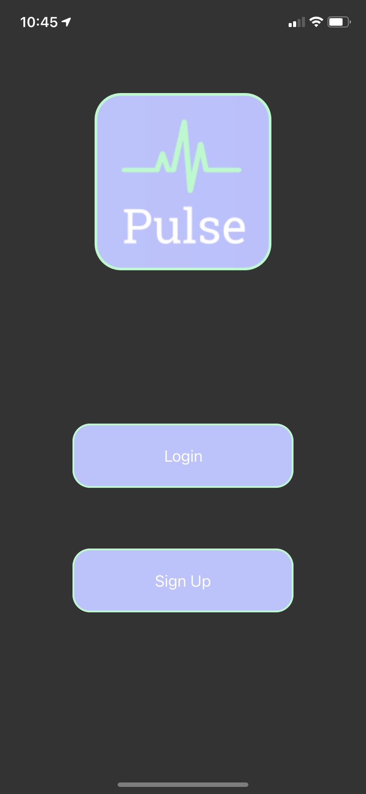
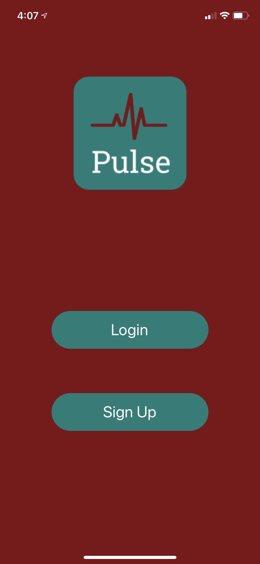
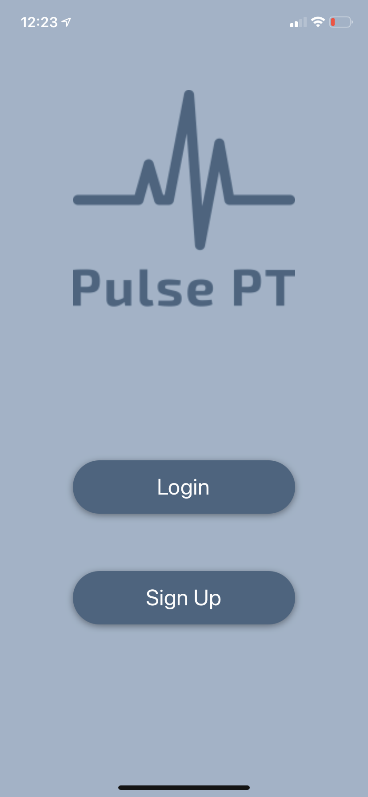
Mobile This Sprint
Subscriber
I would like the app to feel, responsive, look clean with good contrasts and look legitimate

Slide 22
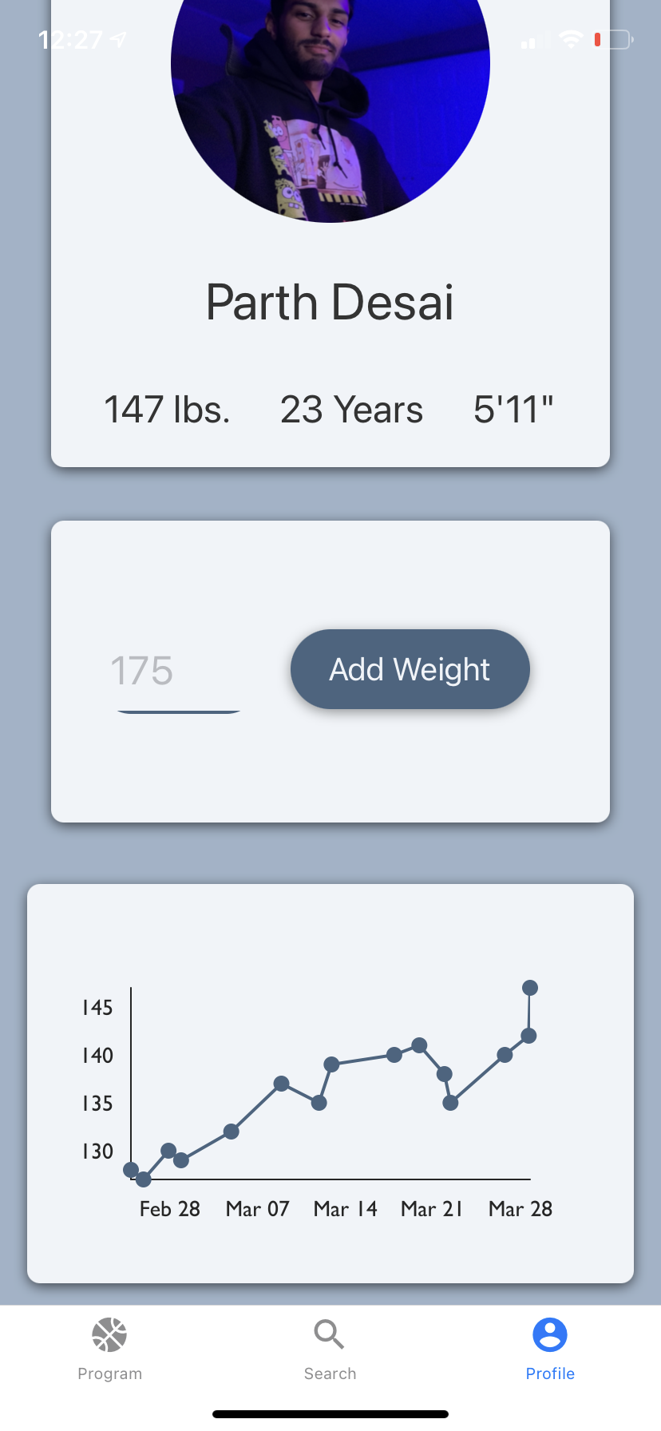
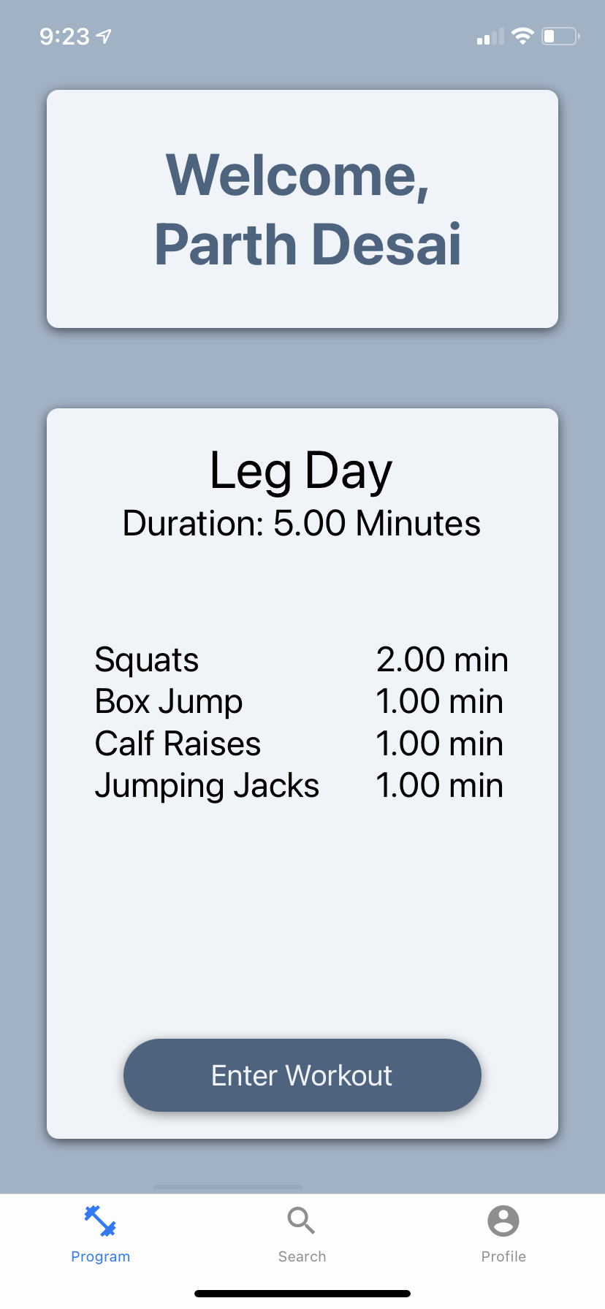
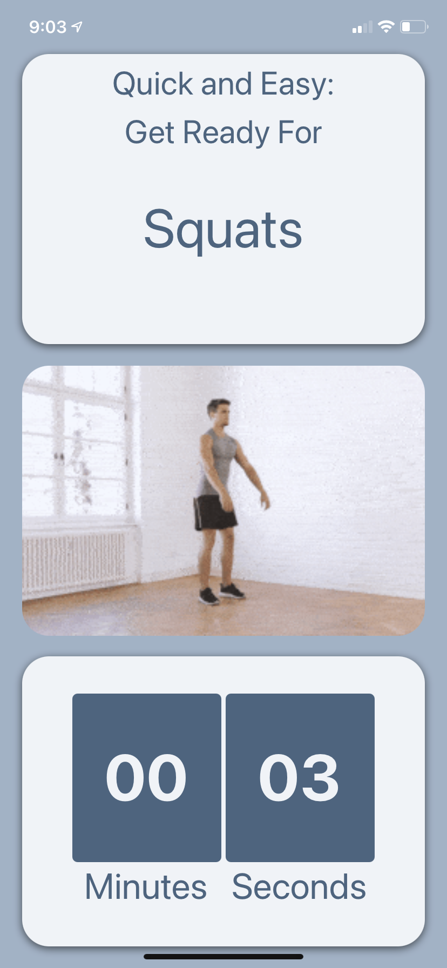
Mobile This Sprint
As a Subscriber
I would like to see my past weights displayed on my profile in a graph to my progress over time
I would like to be able to enter and start a workout
I would like a break before each workout

Slide 23
Mobile Next Sprint
Subscriber
I will be focusing on bug fixes and documentation

Slide 24
Demo

Slide 25
THANKS

